Slide 1
WEB PHISHING DETECTION BY MACHINE LEARNING TECHNIQUES

Slide 2
INTRODUCTION
Phishing is the most commonly used social engineering and cyber attack.
Through such attacks, the phisher targets naïve online users by tricking them into revealing confidential information, with the purpose of using it fraudulently.
In order to avoid getting phished,
Users should have awareness of phishing websites.
Blacklist of phishing websites which requires the knowledge of website being detected as phishing.
Detect them in their early appearance, using machine learning and deep neural network algorithms.
Machine learning based method is proven to be most effective than the other methods.
Even then, online users are still being trapped into revealing sensitive information in phishing websites.

Slide 3
OBJECTIVES
A phishing website is a common social engineering method that mimics trustful uniform resource locators (URLs) and webpages.
The objective of this project is to train machine learning models on the dataset created to predict phishing websites.
Both phishing and Legitimate URLs of websites are gathered to form a dataset and from them required URL and website content-based features are extracted.
The performance level of each model is measures and compared.

Slide 4
APPROACH
Below mentioned are the steps involved in the completion of this project:
Collect dataset containing phishing and legitimate websites from the open source platforms.
Write a code to extract the required features from the URL database.
Analyze and preprocess the dataset by using EDA techniques.
Divide the dataset into training and testing sets.
Run selected machine learning and deep neural network algorithms like SVM, Random Forest on the dataset.
Write a code for displaying the evaluation result considering accuracy metrics.

Slide 5
DATA COLLECTION
Legitimate URLs are collected from the dataset provided by University of New Brunswick, https://www.unb.ca/cic/datasets/url-2016.html.
From the collection, 5000 URLs are randomly picked.
Phishing URLs are collected from Open Source service called Phish tank . This service provide a set of phishing URLs in multiple formats like CSV, JSON etc. that gets updated hourly.
Form the obtained collection, 5000 URLs are randomly picked.

Slide 6
FEATURE SELECTION
The following category of features are selected:
Address Bar based Features Domain based Features
HTML & JS based Feature
Address Bar based Features considered are:
Domain of URL
Redirection ‘//’ in URL
IP Address in URL
‘http/https’ in Domain name
‘@’ Symbol in URL
Using URL Shortening Service
Length of URL
Prefix or Suffix "-" in Domain

Slide 7
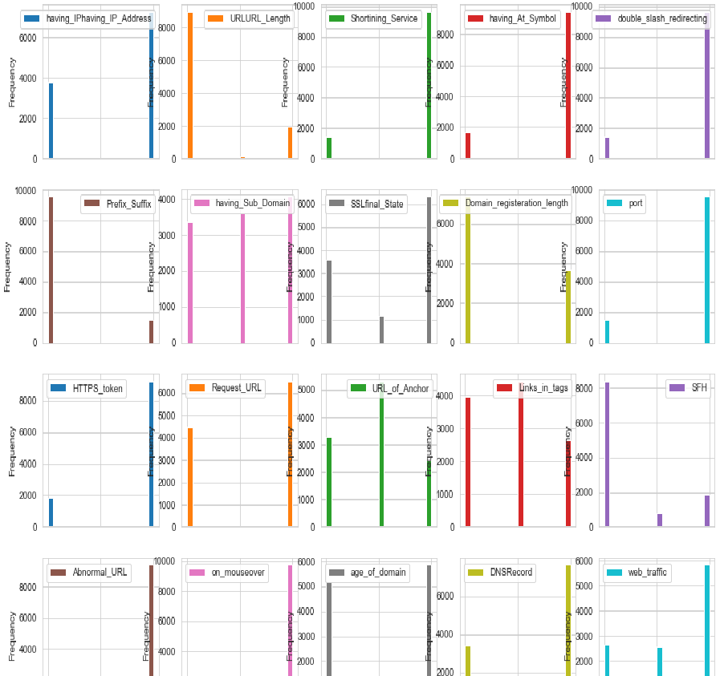
FEATURES DISTRIBUTION

Slide 8
MACHINE LEARNING MODELS
This is a supervised machine learning task. There are two major types of supervised machine learning problems, called classification and regression.
This data set comes under classification problem, as the input URL is classified as phishing (1) or legitimate (0). The machine learning models (classification) considered to train the dataset in this notebook are:
Decision Tree
Random Forest
Decision Tree Classifier
Logistic Regression
Support Vector Machines
Ada Boost Classifier

Slide 9
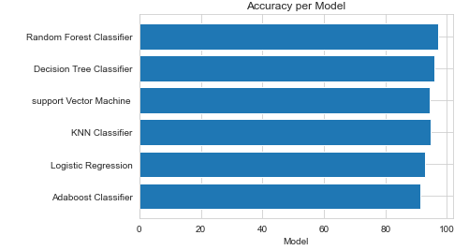
MODEL EVALUATION
The models are evaluated, and the considered metric is accuracy.
Below Figure shows the training and test dataset accuracy by the respective models

Slide 10
CONCLUSION
Working on this project is very knowledgeable and worth the effort.
Through this project, one can know a lot about the phishing websites and how they are differentiated from legitimate ones.
This project can be taken further by creating a browser extensions of developing a GUI.
These should classify the inputted URL to legitimate or phishing with the use of the saved model.

Slide 11
THANKYOU…..

